Slide 1


Enabling organizations to grow, innovate, and evolve with confidence

Slide 2


wavz Vision and Mission
TO BECOME THE REGION’S TRUSTED VISIONARY PARTNER, ENABLING ORGANIZATIONS TO GROW, INNOVATE, AND EVOLVE WITH CONFIDENCE
Vision
WE EMPOWER ORGANIZATIONS WITH AN INNOVATIVE PORTFOLIO OF ADVISORY AND OPERATIONAL SERVICES, COMBINING DELIVERY EXCELLENCE AND PARTNERSHIPS TO ENSURE RESILIENT AND SUSTAINABLE GROWTH
Mission
Riyadh
Established
Cairo
2008

Slide 3









Our Approach
From Vision to Results: We deliver digital transformation through a structured, end-to-end journey designed to maximize value and minimize disruption.
01
02
Assess
Roadmap
Evaluating your current state, identifying critical risks, and uncovering high-value digital opportunities.
Prioritizing initiatives and defining a strategic path to achieve desired business outcomes efficiently.
Value
Lifecycle
Continuous
Improvement
04
03
Run & Operate
Implement
Managed services with guaranteed SLAs, continuous monitoring, and ongoing performance optimization.
Delivering solutions with strict governance, QA standards, and seamless technical integration.

Slide 4
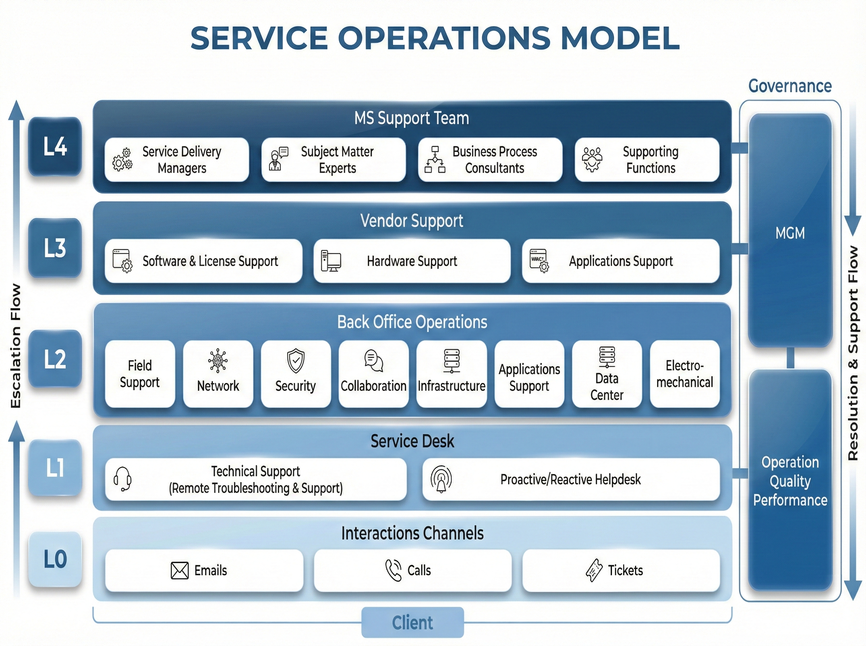
Service operations Model
Operational Excellence at Scale

Slide 5
Clients
WAVZ Solutions Portfolio
Our comprehensive portfolio spans the entire digital spectrum, delivering end-to-end capabilities from infrastructure to application management.
Strategic Alliances
External Influences
Managed Services
Alignment
Integrated Capabilities
A holistic approach combining
Managed Services
SAP Solutions & Services
Data & AI Solutions
Oracle Technology Solutions
SAP Solutions & Services
Data & AI Solutions
Solutions
Oracle Technology Solutions
Testing Services
Technology Partners
Enablement
Governance
Guidance
Advice
Advice
Alignment
Project Management Office
Products & Services
Business Development
Channel Alliances

Slide 6












Managed Services Portfolio
Integrated operations that reduce risk, optimize cost, and maximize uptime
Service Operation
Center (SOC)
CCC Command &
Control Center
Unified Service operations for services up-time continuity, detection, response, and prevention across the IT landscape.
Centralized monitoring and command for security, surveillance, and incident coordination across critical assets.
Network Operation
Center (NOC)
Application Managed
Service (AMS)
24/7 network monitoring and administration to maintain stability, reduce downtime, and protect critical operations.
Detection • Response • Protection
Monitoring • Coordination • Critical
Application maintenance, enhancements, and support to improve performance, reliability, and cost efficiency.
24/7 • SLA • ITIL
WAVZ
Managed
Services
Maintenance • Enhancements • Support
One operating model.
Multiple service towers.
Cloud Managed
Services
PMO & Decision
Support
Cloud operations across IaaS/PaaS/SaaS, modernization, migration support, and real-time monitoring.
Data Centre
Operations
Field
Operations
Program governance, KPI reporting, and decision enablement to drive disciplined execution and measurable outcomes.
IaaS/PaaS/SaaS • Migration
Operational governance for data center efficiency, availability, capacity, and lifecycle planning.
On-site deployment, maintenance, and technical support to ensure service continuity and fast remediation.
Governance • KPI • Enablement
Governance • Availability • Efficiency
On-site • Deployment • Support
24/7 Operations & SLA Discipline
Risk Reduction & Faster Response
Cost Optimization & Service Visibility

Slide 7
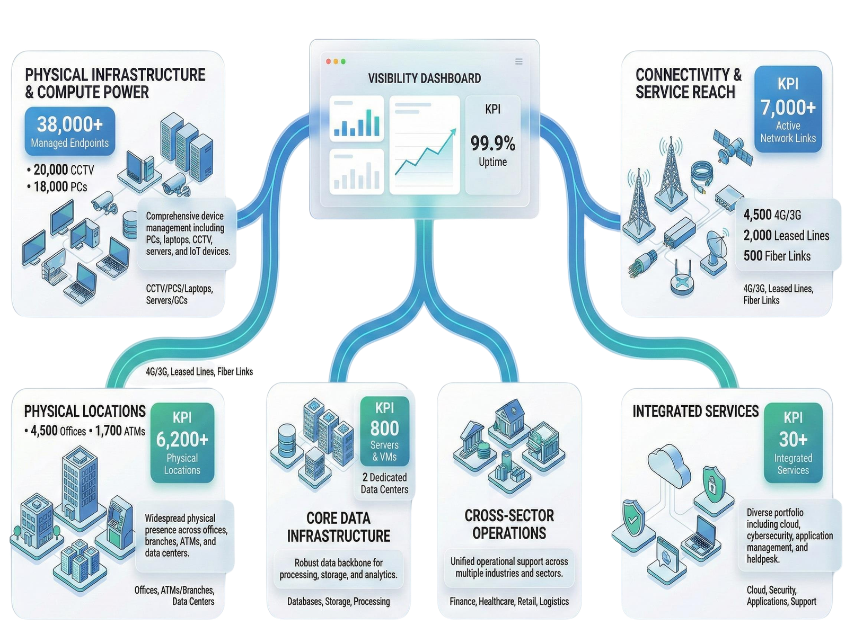
Managing and Operating

Slide 8






Why Managed Services
We alleviate the burden of IT infrastructure management, allowing you to focus on core business activities while enhancing operational efficiency and reliability.
End-to-End Operations
SLA-Driven Delivery
Enhanced Resilience
Comprehensive management across your entire infrastructure and application landscape, ensuring seamless integration and uptime.
Commitment to rigorous Service Level Agreements (SLAs) that guarantee performance standards, accountability, and timely resolution.
Proactive monitoring and optimization to improve system stability, enhance security posture, and deliver measurable cost control.

Slide 9














Oracle Services Portfolio
End-to-End Delivery Across Cloud, On‑Premise, and Hybrid Environments
1
Our Solutions and Services
Hardware &
Systems /OCI services
Cloud Apps
(SaaS)
Unlimited &
Custom Apps
Managed
Services
Exadata, PCA, ODA
Oracle Fusion Cloud
E-Business Suite (EBS)
24/7 Monitoring /including hotline
Servers & Storage
CX / JDE / Seibel / etc.
Siebel Modernization / FLEXCUBE
OCI Tenancy Mgmt
Lifecycle Services
Domain Solutions
APEX Low-Code
Continuous Ops / Hotline / TAM
2
How We Deliver
3
Why Us
Hybrid-Ready Delivery
OCI Dedicated Region & Cloud at Customer ensuring data residency.
Performance & Innovation
Exadata Smart Scan, Vector Search & AI-driven database features.
Full-Stack Expertise
Integrated knowledge across Hardware + Applications + Cloud layers.
Assess & Plan
Implement
Run & Optimize
Strategy, Target Arch,
Value Case
Migrate, Build,
Integrate
SLA, Enhancements,
FinOps

Slide 10



SAP Services Portfolio
As a certified SAP partner, we provide end-to-end implementation, optimization, and support services to drive enterprise efficiency and innovation.
Implementation Services
Optimization Services
Support Services
Extensive experience in implementing SAP S/4HANA next-generation ERP solutions tailored to your infrastructure needs.
Expertise in turning around troubled implementations and streamlining existing operations for maximum ROI.
Comprehensive lifecycle support ensuring your SAP landscape evolves with your business.
Traditional On-Premise deployment for maximum control
Rescue of stalled or failing projects
Ongoing Support: Dedicated maintenance and troubleshooting
Process re-engineering and simplification
Public Cloud deployment for scalability and speed
Upgrades & Migration: Seamless transition to latest versions
Performance tuning and system stabilization
Private Cloud deployment for secure flexibility
User experience enhancement (Fiori)
Health Checks: Regular audits and proactive optimization
Best-practice industry templates and accelerators
24/7 Monitoring and Incident Management

Slide 11



Data & Ai Portfolio
Transforming Insight into Impact — We are technology-agnostic, partnering with global leaders like Teradata, Microsoft, Informatica, Qlik, Quest, UiPath and many others to serve your specific needs.
Data Foundation
Modern Analytics
AI & Automation
Building a robust, governed backbone for your organization's information architecture.
Turning raw data into actionable intelligence through modern platforms and testing.
Accelerating innovation and efficiency with cutting-edge artificial intelligence.
Data Management & Integration: Seamlessly connecting disparate sources.
Warehousing & Modern Platforms: Scalable architectures for big data.
Generative AI Solutions: Creating new value through advanced models.
Data Governance & Quality: Ensuring accuracy, compliance, and trust.
Analytics & BI: Visualizations that drive strategic decision-making.
Agentic AI: Autonomous agents that execute complex tasks.
Data Migration: Secure and efficient transfer of critical assets.
Data & Application Testing: Rigorous validation for reliability.
Intelligent Automation: Streamlining workflows with cognitive tech.

Slide 12




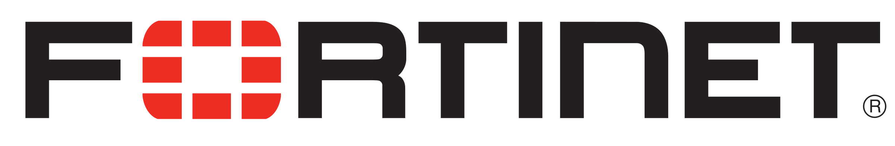

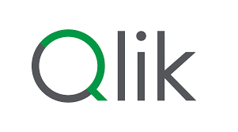



our partners

Slide 13










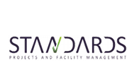










Our Clients

Slide 14
Our Clients
SAP
BI & Testing
Managed Services

Slide 15





Why wavz
Seasoned Expertise
Consultants with deep hands-on experience across banking, communications, and government sectors where precision is mission-critical.
WHY
WAVZ?
Technology Agnostic
We design solutions based solely on what serves your business outcomes best, not tied to a single platform or vendor constraint.
Your trusted partner for resilient and sustainable growth.
Global Partnerships
Strategic alliances with market leaders like Microsoft, SAP, Oracle, and Teradata to bring world-class capabilities to your local environment.
Proven Delivery Excellence
Established in 2008 with a track record of reliability, strict governance, and high-performance delivery standards.
Strong Regional Presence
Headquartered in Cairo with a subsidiary in Riyadh (KSA) and an extended partner network serving the entire Middle East & Africa region.

Slide 16






Contact us
Ready to Accelerate Your Digital Journey?
Visit Us
Call Us
Maadi Technology Park,
Block MB3, Building B2,
Cairo, Egypt
+2 02 2120 1430
Sun-Thu, 9am - 5pm
Book a discovery call or request a comprehensive digital maturity assessment with our experts today.
Schedule Consultation
Email Us
Online
info@wavz.com.eg
wavz.com.eg
For general inquiries
Latest news & updates

Slide 17
Thank You

